Slide 1
Let us begin by saying together
Let everything we do and say this day be:
In the name of the Father and of the Son and the Holy Spirit

Slide 2
Gospel Luke 16 1-13
Trust
“The man who can be trusted in little things can be trusted in great.”

Slide 3
Gospel Reflection
Trust
Assurance
Confidence
Duty
Safekeeping
Confide
Bank on
Faith
Reliance
Care
Depend on
Entrust
Expectation

Slide 4
St Gregory’s is a
LISTENING
school
St Gregory’s is a
TELLING
school
‘If you don’t share a risk... you own the risk’

Slide 5
Safeguarding Team
OUR MISSION STATEMENT
Committed to ensuring the safety and wellbeing of everyone in our community.
‘We work in partnership to create a living and vibrant community in which each member is valued’
...everyone deserves to be listened to and treated with respect and dignity...

Slide 6
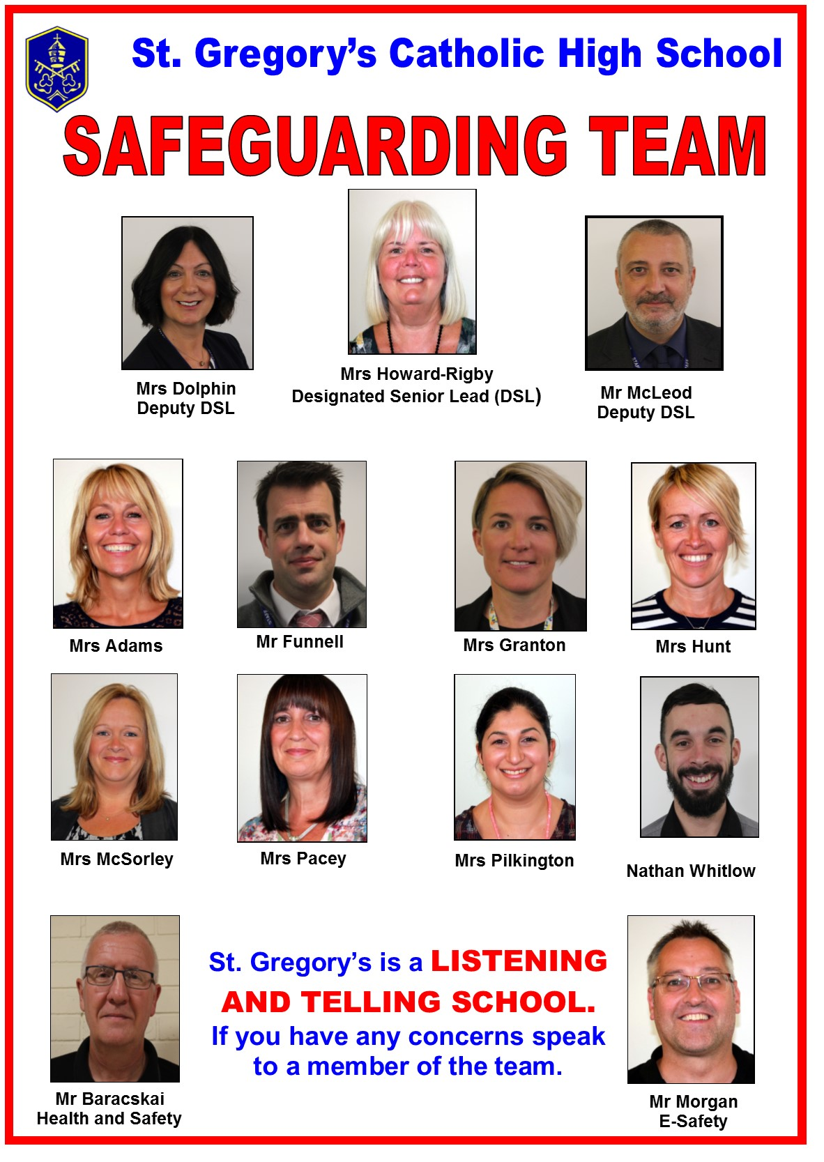

Slide 7
Daily Care and Support
Form Tutor
Pastoral Support Managers – Mrs Cotter-Day/ Miss Dolphin/ Mrs Lee
Pupil Progress Manager
Chaplain – Nathan
Emotional Health and Well-being – Mrs Mc Sorley
Health and Safety Team - Site Staff

Slide 8
Who Else?
You
Friends
Teachers
Augustine Centre staff
PCSO
School Health Advisor (Tuesdays) – Margaret Jaber
External Mentors
Outside Agencies – Kooth
Zumos
Peer Mentors
Young Leaders
Anti-bullying Ambassadors
Youth Health Champions
2%ers
Intervention Groups

Slide 9
Information Areas
Noticeboard by Dining Room
Young Carers’ board by Staffroom
LRC – staff, books, leaflets
Sharp System: on-line reporting
Displays eg Hate Crime/Anti-Bullying/Alcohol/ Mental Health
Learning Organiser

Slide 10
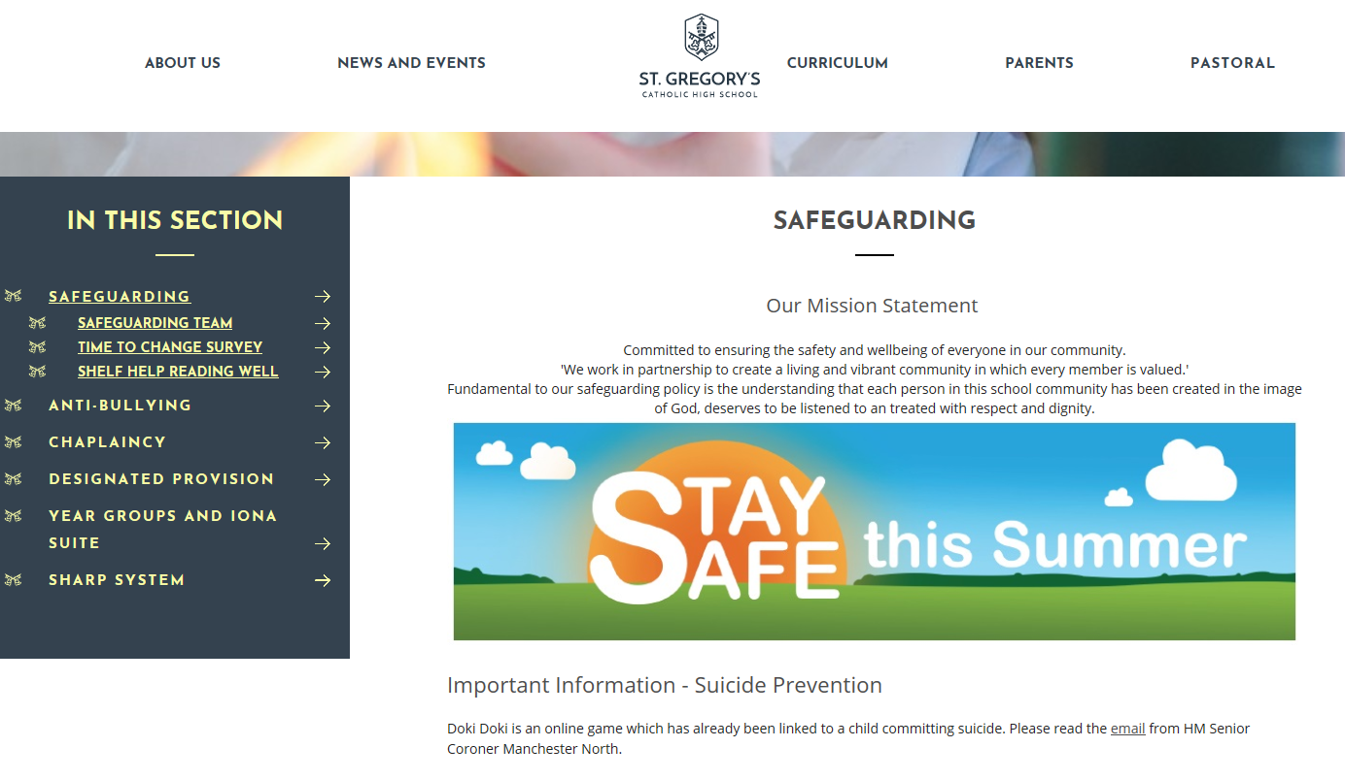
Information Areas
Personal Development sessions
IT Lessons
Theme Days e.g. Time to Talk/ Suicide Prevention
Toilet doors
The Net – websites/ telephone numbers
Safeguarding Newsletter
Collective Worship
School Website and links

Slide 11
Supportive Measures
Mobile Phone Policy
Everyone wearing their identification badge
Signing in and out of school
Daily Register/Being on time
Out of Class Passes
Visitors signing in
Electronic Gate
CCTV
Keeping to the left on corridors and stairs
Bikes walked on and off premises
Use of Eco bins
Duty zones
No fizzy/energy drinks
Uniform

Slide 12
Safeguarding Issues
Social Media–cyber bullying/ sexting
Mental Health/ Sectioning/ Depression
Physical/Emotional/Sexual abuse
Self Harm/Attempted suicide
Body Image– eating disorders
Domestic Violence
Drugs-taking/supplying/dealing
Smoking/Alcohol
Gangs –peer pressure
Bullying/Hate Crime
Missing from home
Arson
Theft/shop lifting
On-Line Gaming/gambling
Bereavement/ Terminal Illnesses
Child Sexual Exploitation
Grooming
Radicalisation/ Extremism
Sexual Orientation/ Transgender
Imprisonment of Family Member
Dementia
Legal Highs
Run Hide Tell (Terrorism)
Burglary
Hoax News

Slide 13
National Issues
Anxiety 15%
Self Harm (8.7%)
Depression (8.3%)
Suicidal Intentions (5.3%)
Eating Disorders (4%)

Slide 14
Social Media
Jesy Nelson
Sian Waterhouse

Slide 15
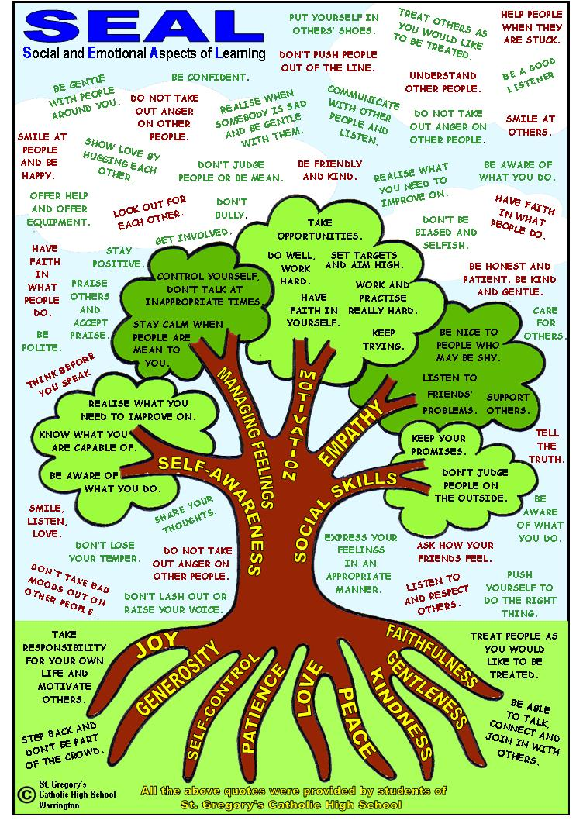

Slide 16
Let us say together:
Jesus,
Inspire us to build a community
based on love and respect.
May we be empowered
to challenge injustice every day.
Help us to value and support each other
to create a positive
learning environment where all may serve.
AMEN

Slide 17
Let us end by saying together
Let everything we do and say this day be:
In the name of the Father and of the Son and the Holy Spirit

