Slide 1
Creating Exam Playlists

Slide 2
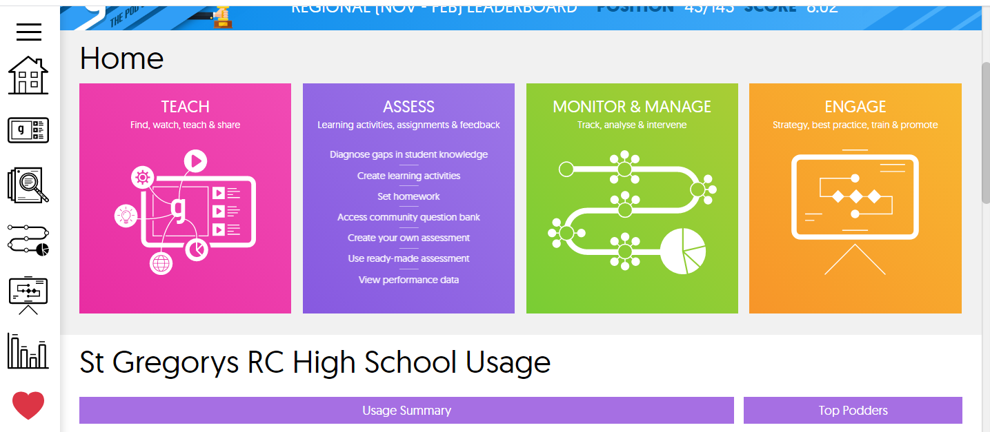
Select Teach

Slide 3
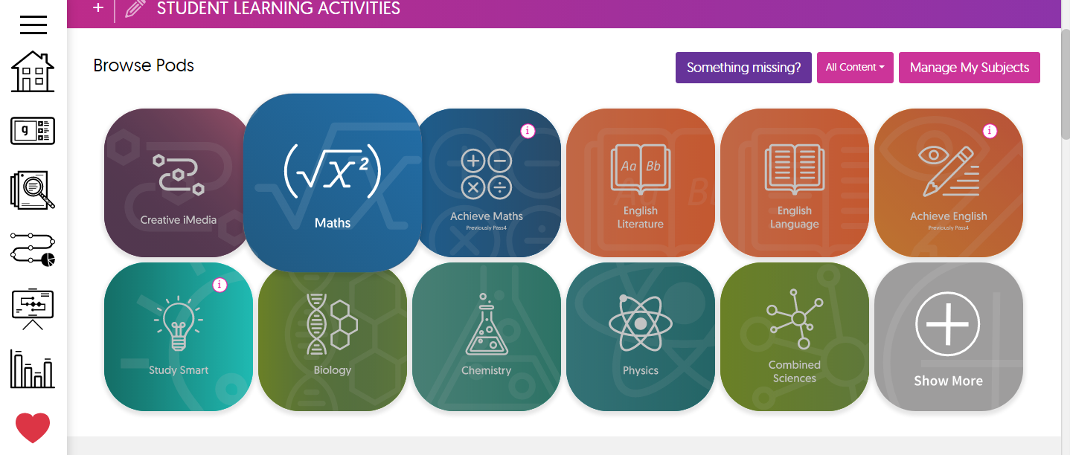
Select subject

Slide 4
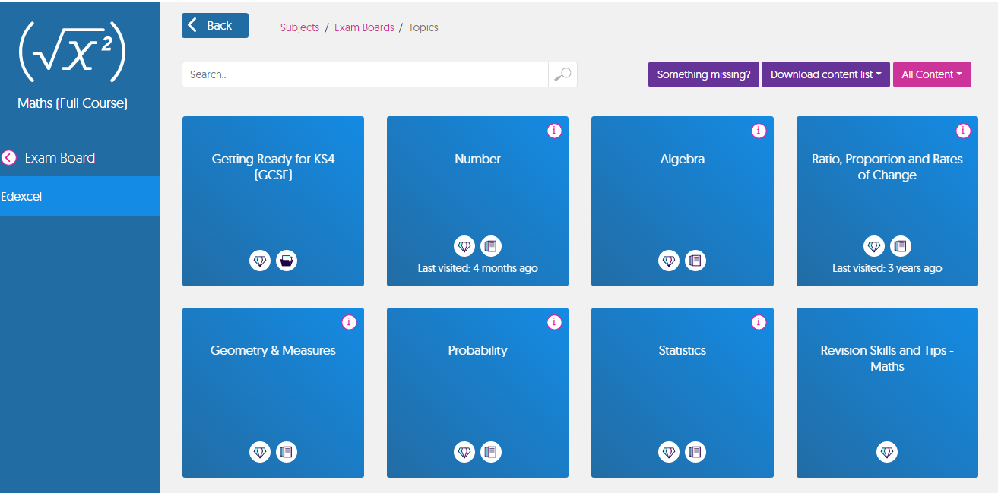
Select topic

Slide 5
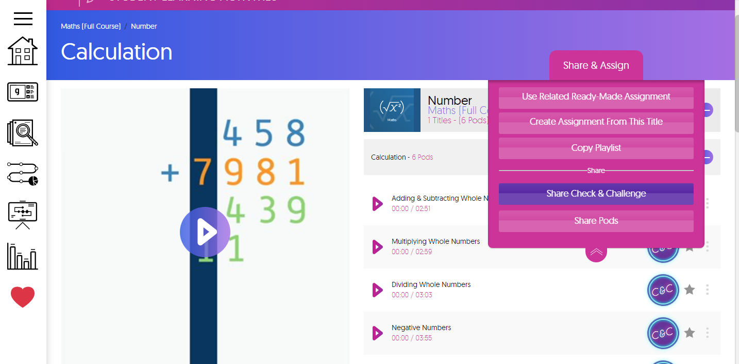
Select share pods

Slide 6
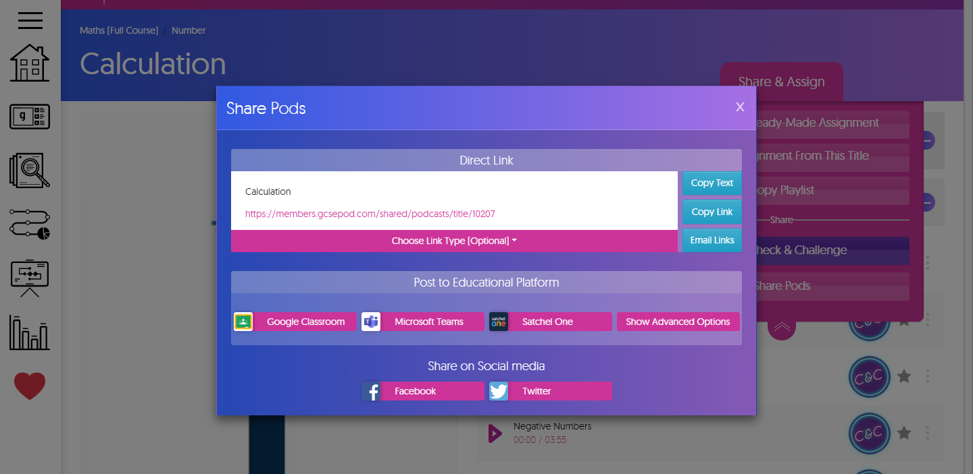
Select share pods

