Slide 1
Check and Challenge
D Jones

Slide 2
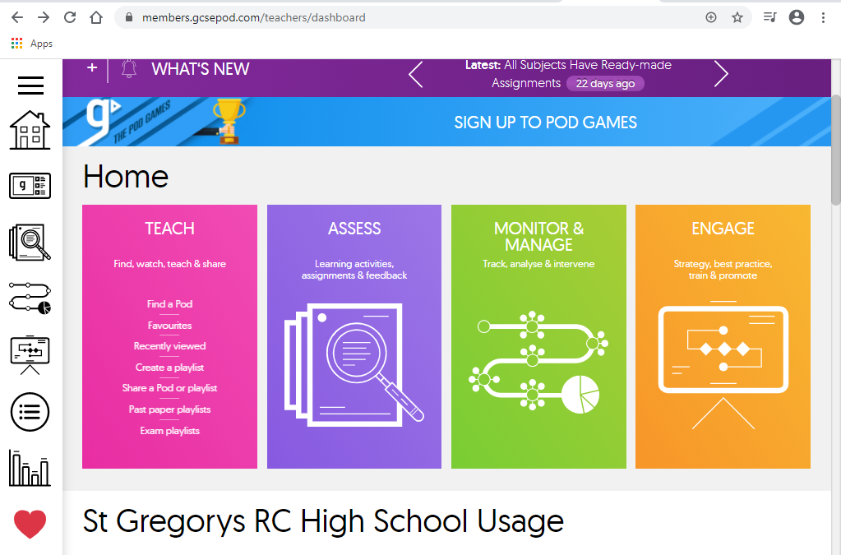
Click teach

Slide 3
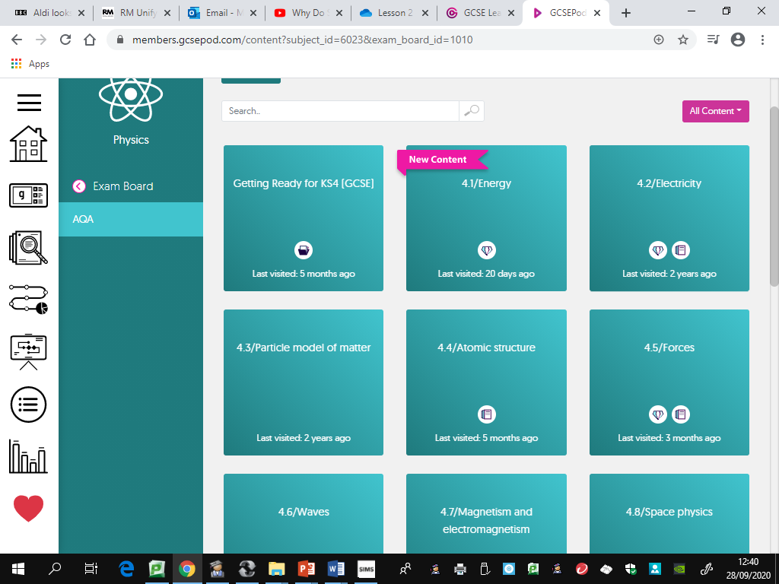
Select a topic with a diamond for check and challenge.

Slide 4
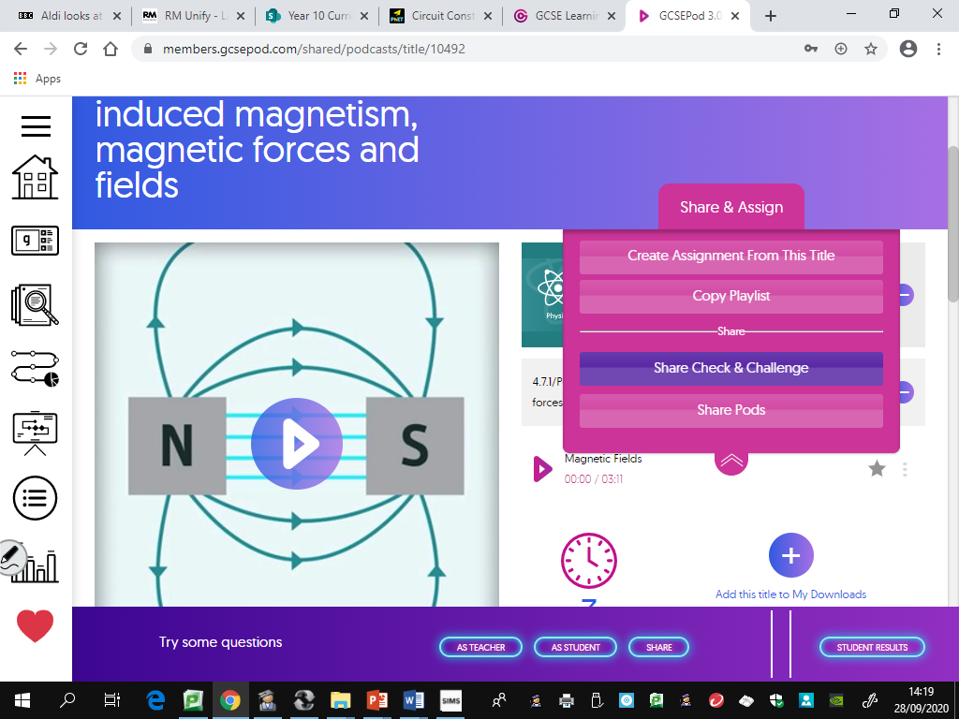
Click Share & Assign, then Share Check & Challenge

Slide 5
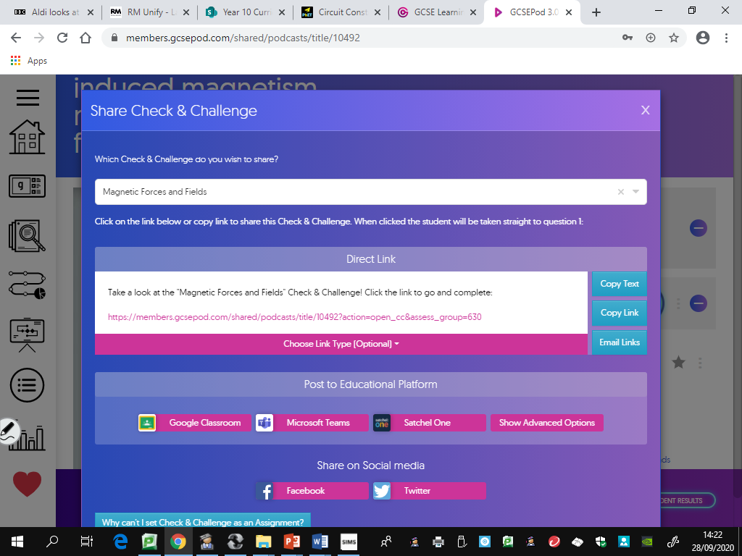
Copy and paste link into ClassCharts

Slide 6
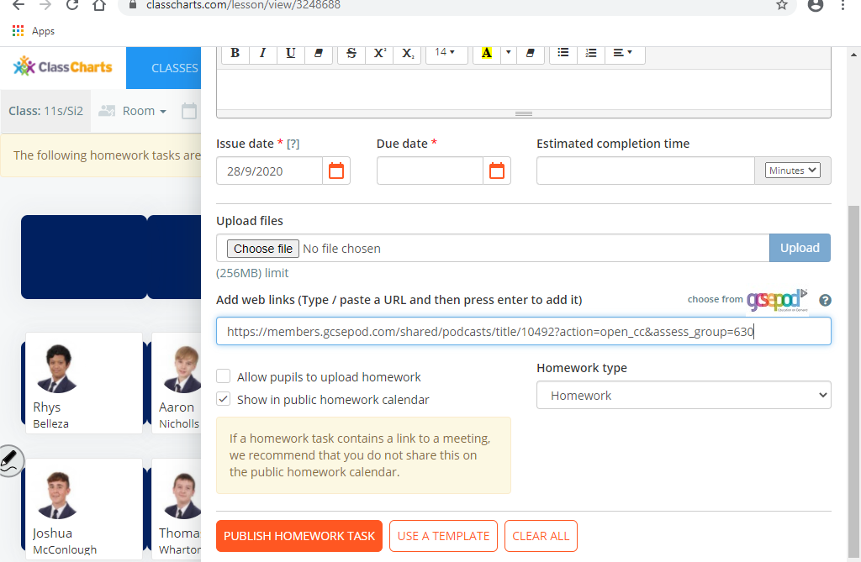
Copy and paste the link into ClassCharts, press enter.

Slide 7
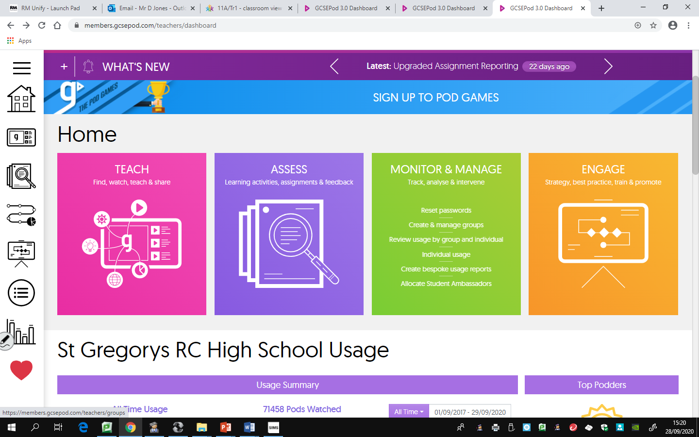
To see results, click assess

Slide 8
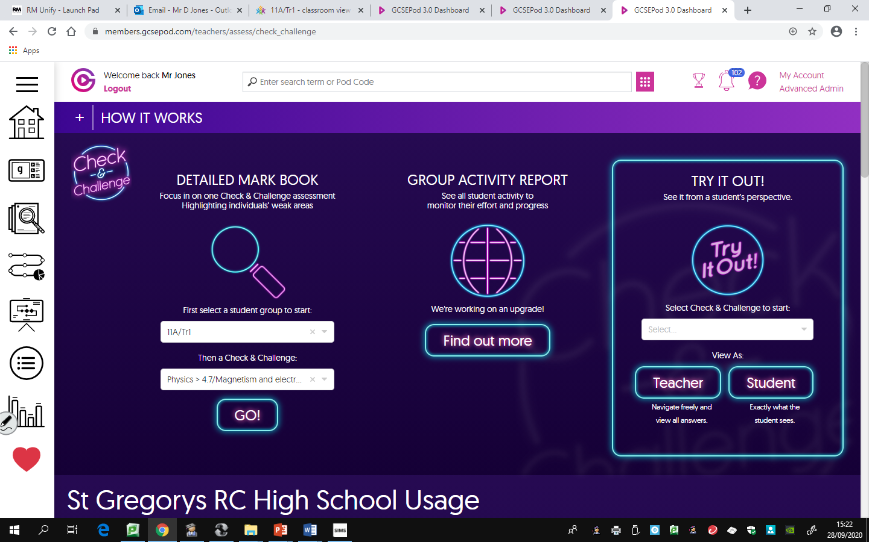
Click Check & Challenge. Choose your class and the check and challenge you set from drop down box.

Slide 9
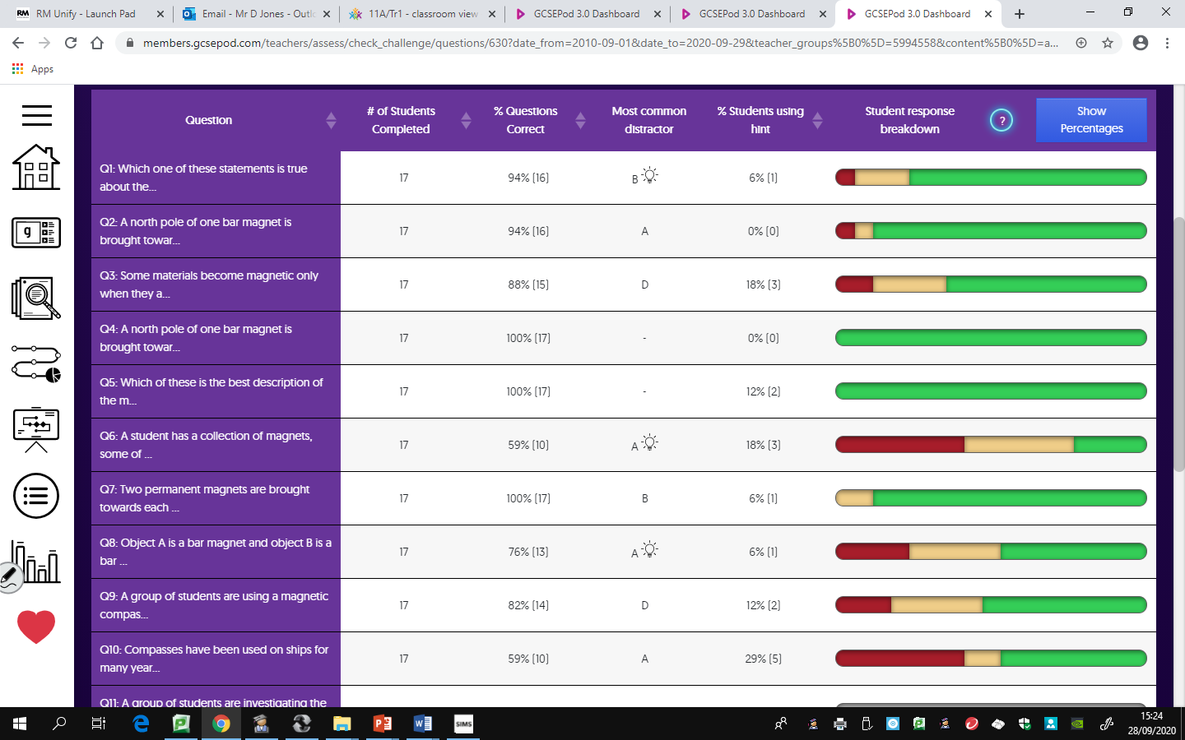
Analyse students results.

