Slide 1

Using GCSEPod to Revise

Slide 2
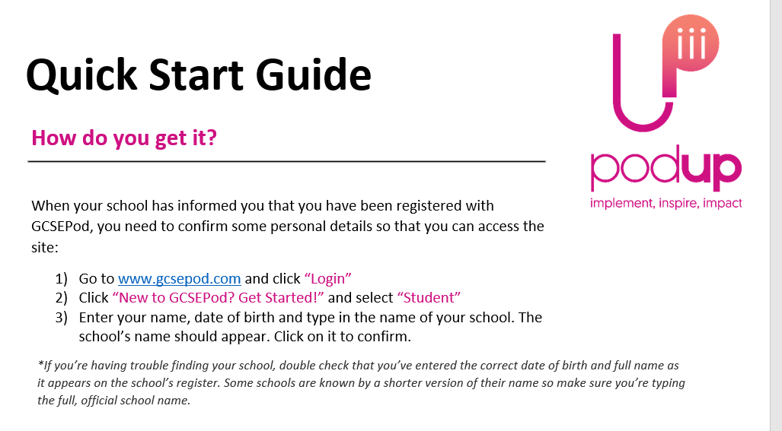

Slide 3

A reminder: What is GCSEPod?
GCSEPod provides you with highly concentrated 3-5 minute bursts of audio-visual, expert-written learning which can help to reinforce and consolidate key GCSE topics.

Slide 4





A reminder: What is GCSEPod?
27 GCSE/IGCSE subjects.
Over 6,500 audio-visual Pods.
Covering every exam board.
Correlation between usage and progress.
One website, three apps.
Available online or offline.
Ability to favourite any Pod (topic) you find difficult.
Pre-made exam playlists, helping to organise revision.

Slide 5

When used effectively, GCSEPod can have a BIG impact on final grades
Data from over 2,200 students shows that higher GCSEPod users are more likely to exceed their predicted grades by a larger margin than those who don’t use GCSEPod.
High academic year usage yielded a greater impact than high usage in just the exam period.
On average, highest users received 3 grades higher across their subjects than predicted.
High Users = average 122 Pods watched in academic year
Medium = average 34 Pods watched in academic year
Low = average 6 Pods watched in academic year
Non Users = 0 Pods watched in academic year

Slide 6

GCSEPod can be used on ANY device

Slide 7

How to find Pods to watch

Slide 8



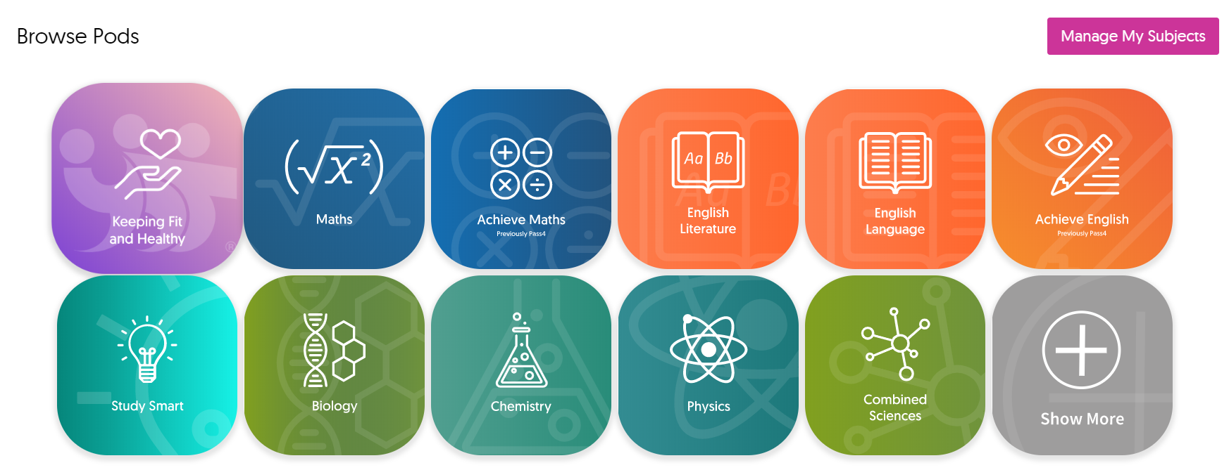
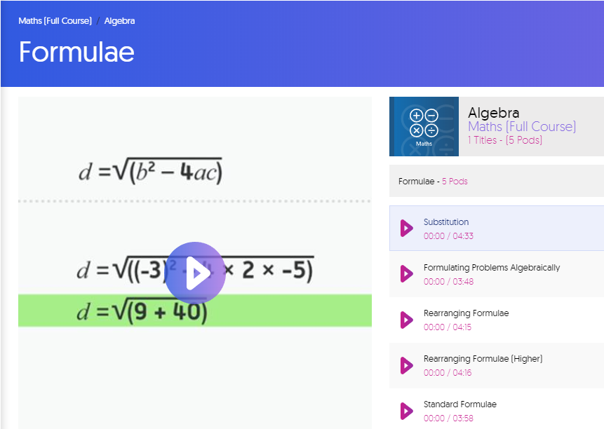
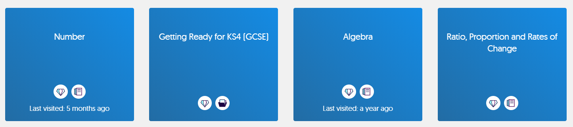
Search for a Topic
1
2
3
Pick your subject
Choose a topic
Start revising

Slide 9
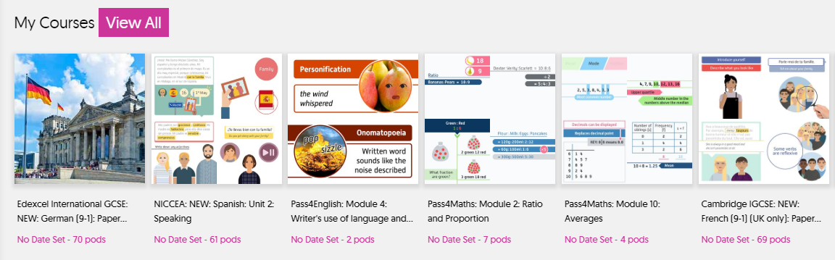
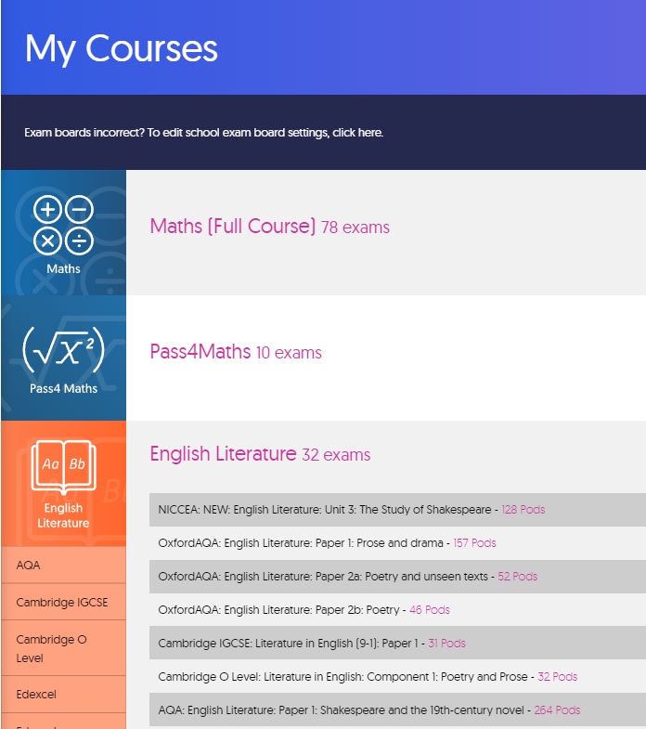
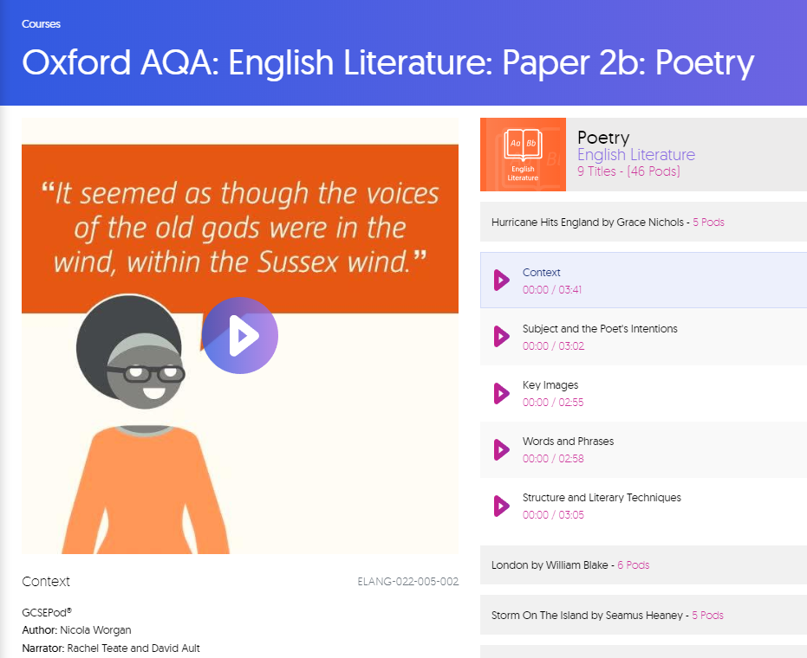
Search for an Exam
1
2
3
Go to My Courses
Choose an exam
Start revising

Slide 10

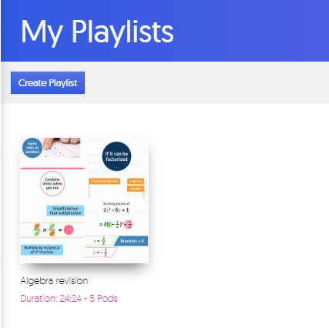
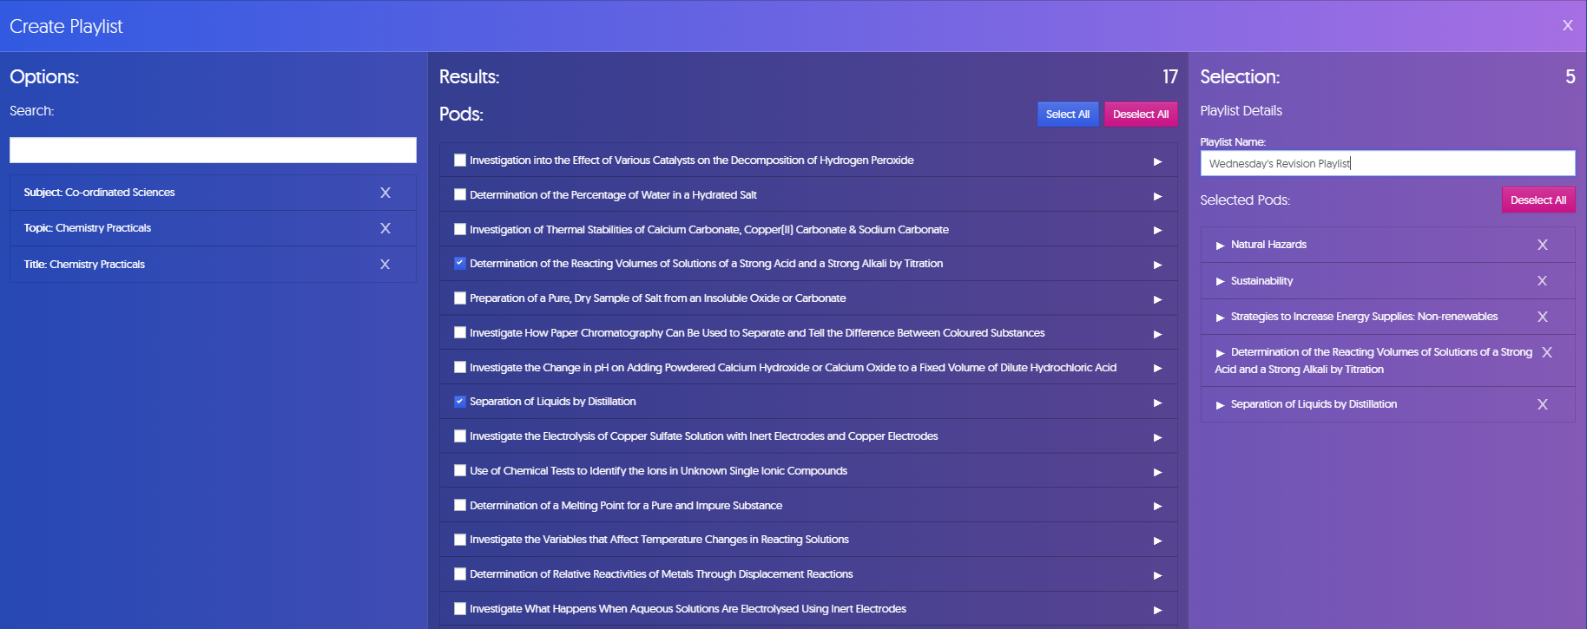
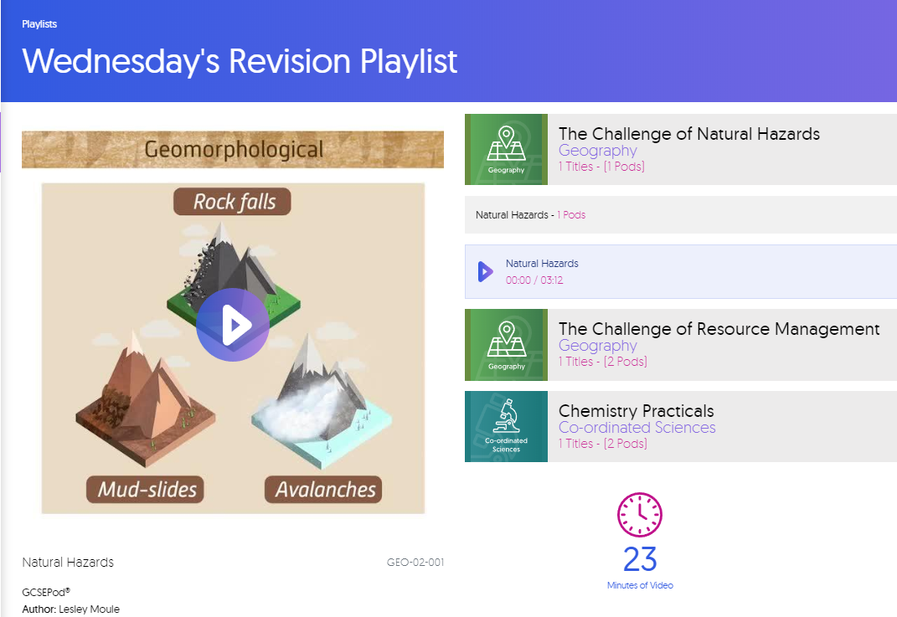
Create a Playlist
1
2
3
Go to My Playlists
Choose Pods
Start revising

Slide 11

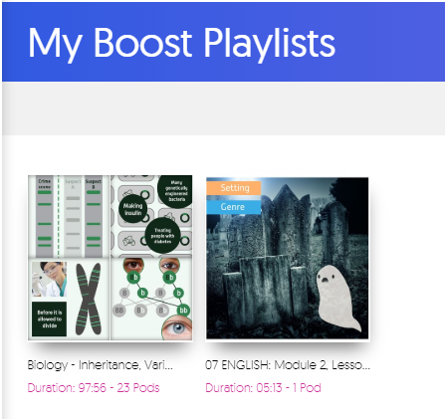
Assignments = Boost Playlists
Ask your teacher to set you an assignment – there are hundreds of questions readily available
You can apply your knowledge to the questions that have been set and get INSTANT results!
Boost Playlists – helps to fill in knowledge gaps
When you complete an assignment, you’ll be given access to a Boost Playlist with recommendations on what you should be watching based on any incorrect answers.

Slide 12


